Slide 1

neo4j Project
Shefali Kamalnakhawa

Slide 2
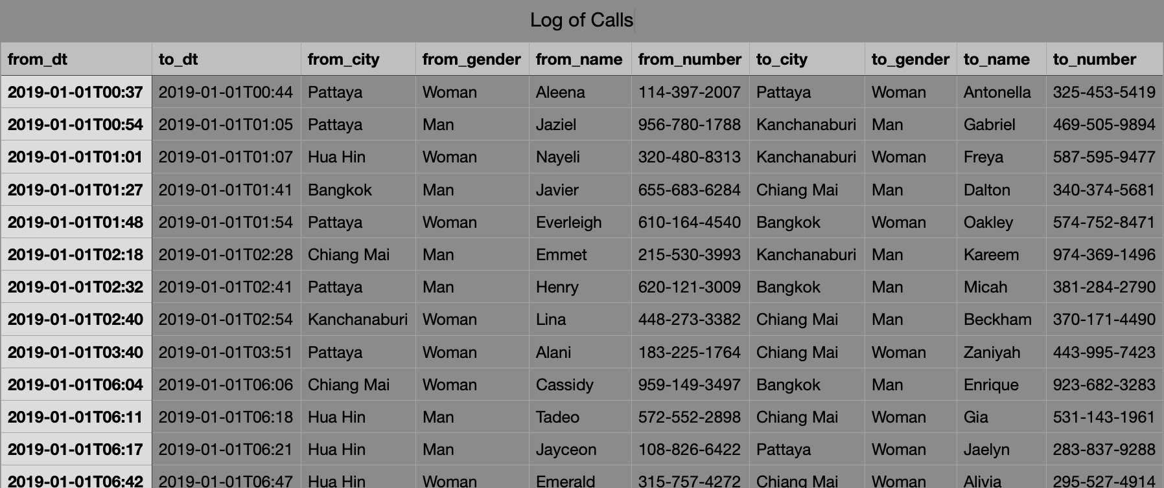
Data
In our data file each row represents the next information: Call start and end timestamp, Person’s name, gender, phone number and city.
In total there are 10 000 calls, 2 000 persons and 5 cities. The file contains information about calls in dates from January 1st 2019 – July 30th 2019

Slide 3
Data Modeling
From each 1 line of data file, we will get 1 node of Call, potentially 2 nodes of Persons and potentially 2 nodes of Cities.
The above example of a row in our data file is represented as: Cassidy made a call to Enrique.
We can now convert this information into a graph using 2 main building blocks: Nodes and Relationships.

Slide 4
nodes
One node to represent Cassidy and one for Enrique.
This is our first two nodes with properties like name, gender, phone number and city.
Both nodes belong to the same “type” — they both represent a Person.
The specified type of node is called Node Label.
One more node we want to extract from the row is a node of Call.
Duration property we can set as minute difference between the start and end of the call.

Slide 5
Merge
MERGE command helps avoid node duplication. If specified structure (node or combination of nodes and relationships) does not exist in the database — then it will be created, otherwise skipped.
There is should be only one Bangkok city in the graph, so this “single instance” requirement should be true for all cities, persons and calls.

Slide 6

create
each row represents a fact of call and we need all of them, we can simply CREATE calls without any issue of duplication. But running this script twice will lead to the creation of same Call nodes again and again. You can try different scenarios to understand the idea.
MATCH (n) DETACH DELETE n;
LOAD CSV WITH HEADERS FROM 'https://vbatushkov.bitbucket.io/log_of_calls.csv' AS line
MERGE (c1:City { name: line.from_city })
MERGE (p1:Person { name: line.from_name, number: line.from_number, gender: line.from_gender })
MERGE (p1)-[:FROM]->(c1)
MERGE (c2:City { name: line.to_city })
MERGE (p2:Person { name: line.to_name, number: line.to_number, gender: line.to_gender })
MERGE (p2)-[:FROM]->(c2)
CREATE (c:Call { from: datetime(line.from_dt),
to: datetime(line.to_dt),
duration: duration.between(datetime(line.from_dt), datetime(line.to_dt)).minutes })
CREATE (p1)-[:OUT]->(c)<-[:IN]-(p2);

Slide 8
Cypher
Cypher — is a declarative query language, built on the basic concepts and clauses of SQL but with added graph-specific functionality. And the main idea to understand is a concept of Graph Pattern Matching.
There are no tables, where we store our data, instead, we have nodes and each one itself know its type by having a Node Label.
Each of these nodes marked by label (:City), (:Person), (:Call) and connected by relationships [FROM], [OUT], [IN] with other nodes.

Slide 9
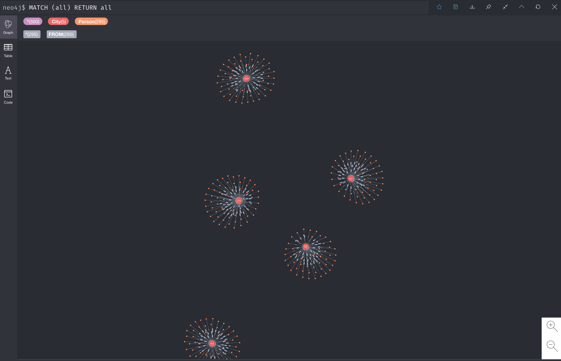

Slide 10
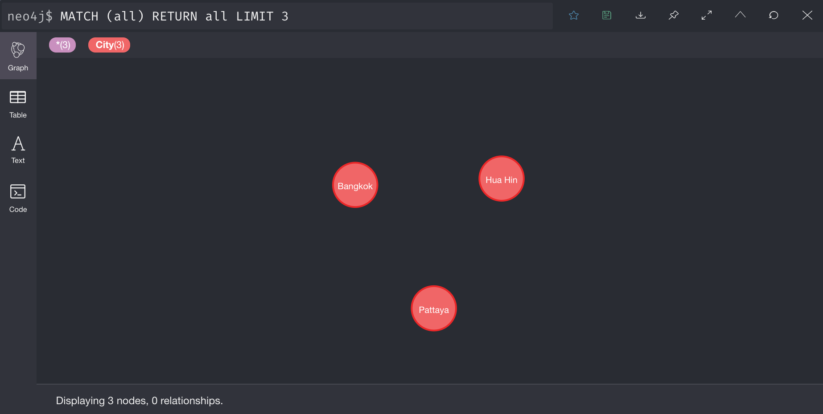

Slide 11
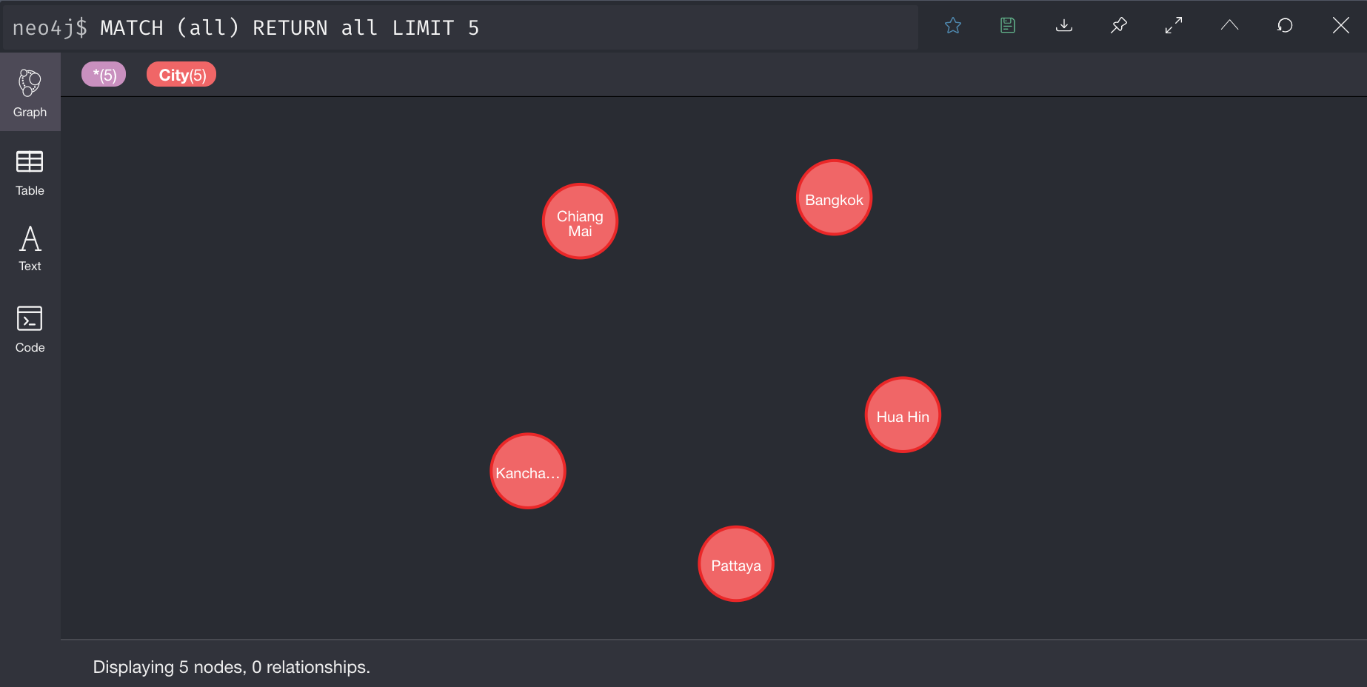

Slide 12
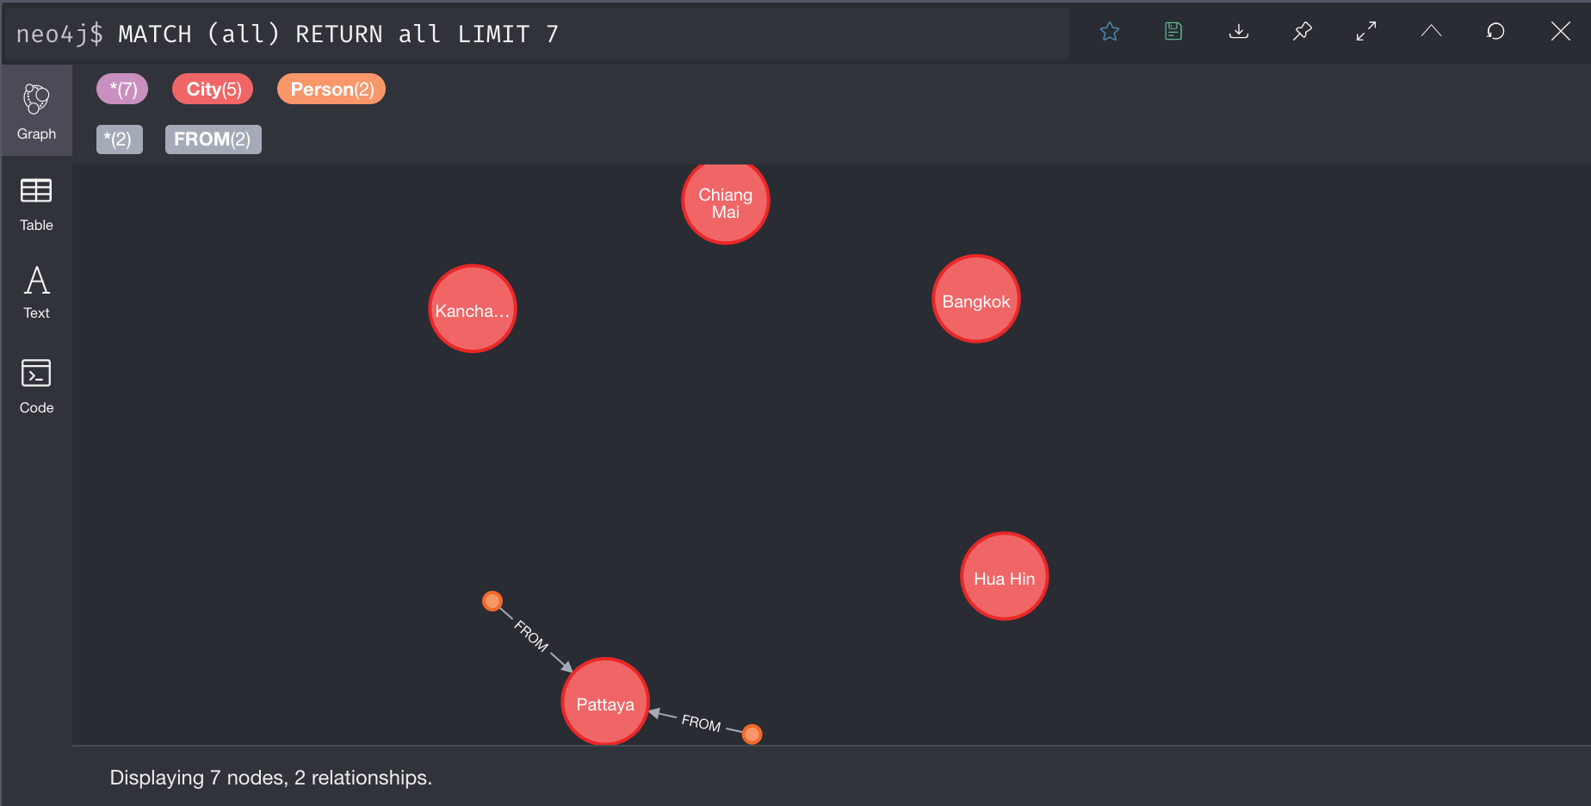

Slide 13
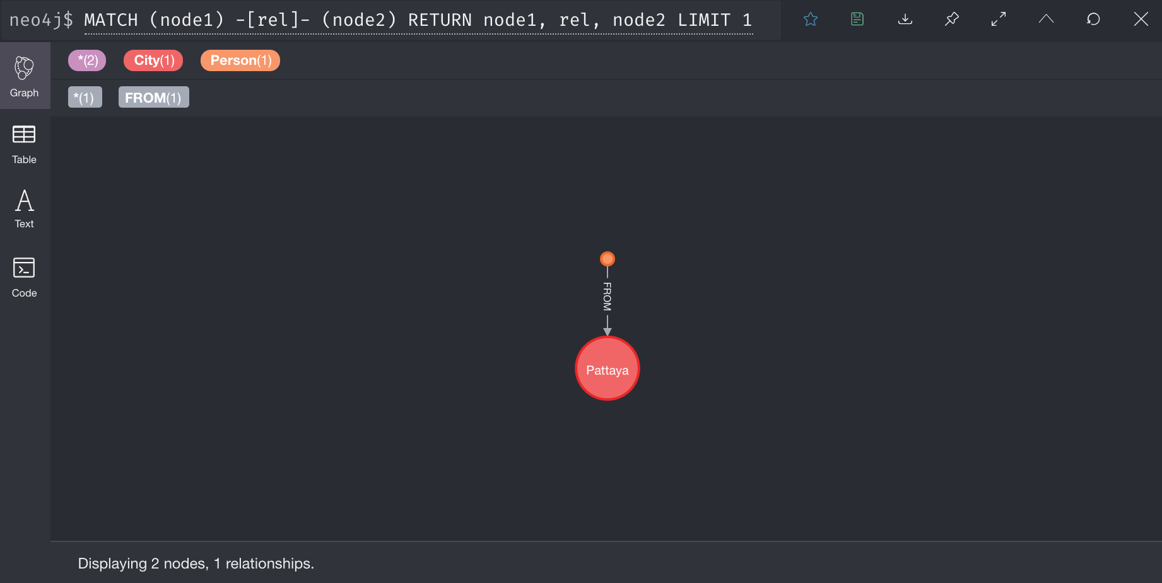

Slide 14
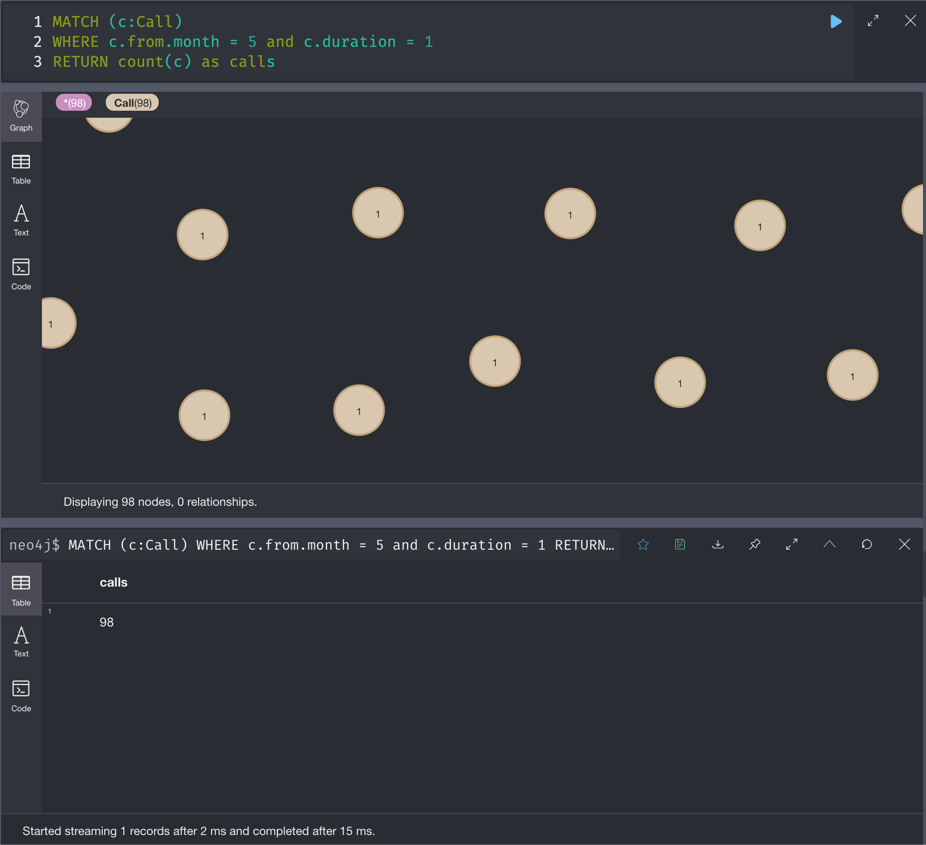
Calls made during month 1 with duration of 1 minute:

Slide 15
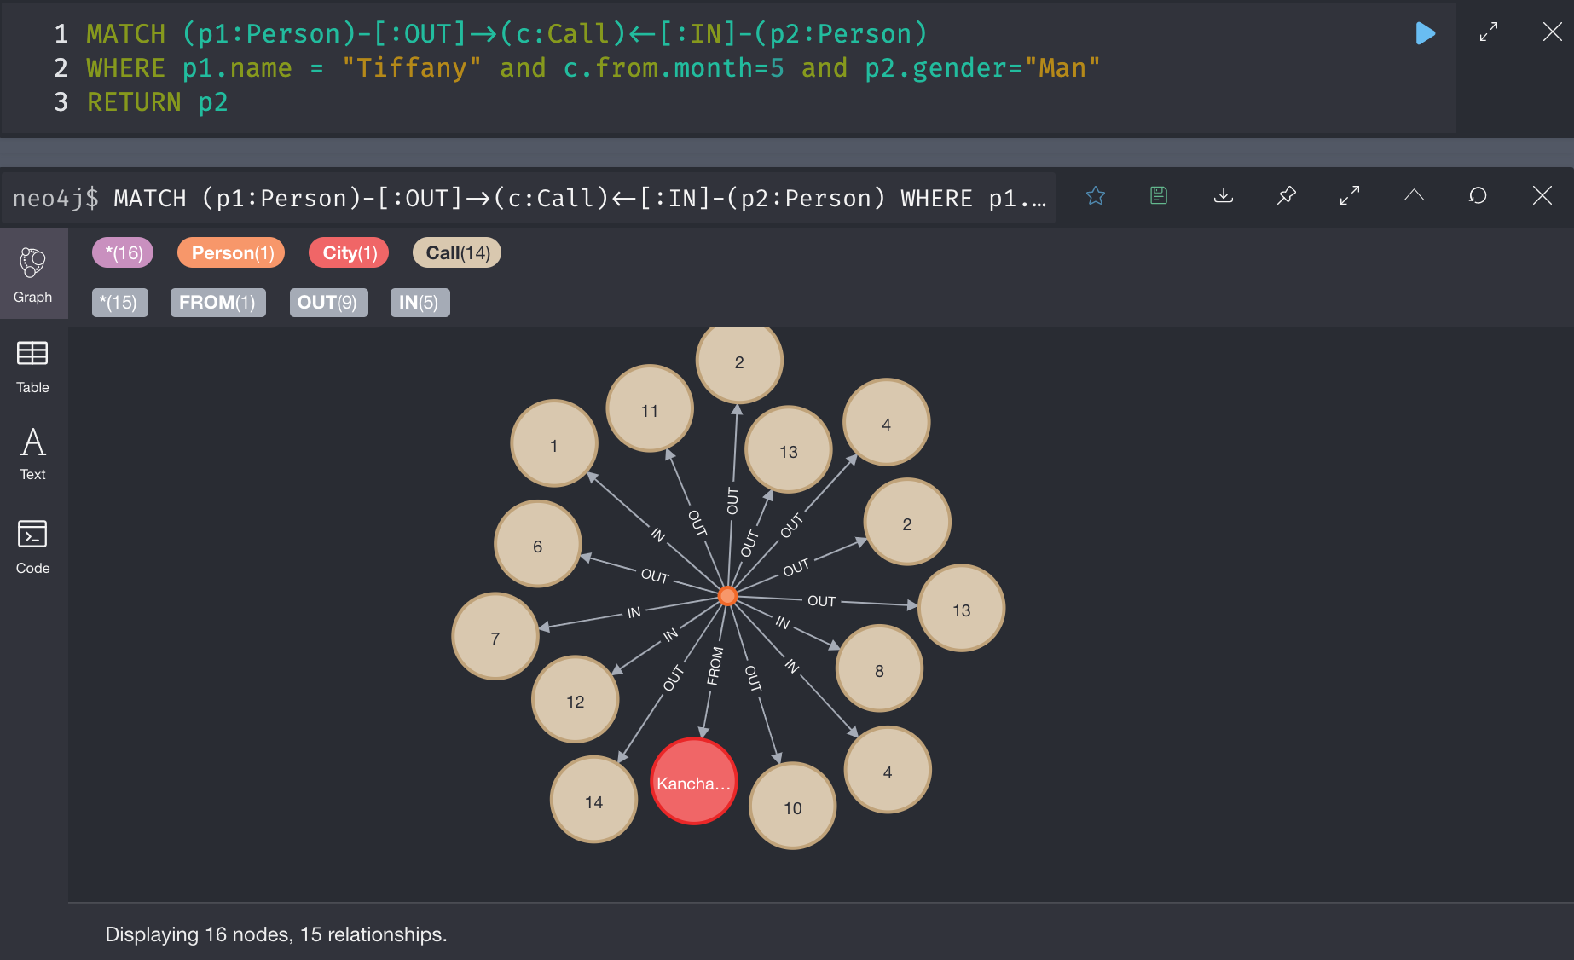
Persons(MALE), who got a call from TIFFANY during month 5 of the log period.

Slide 16
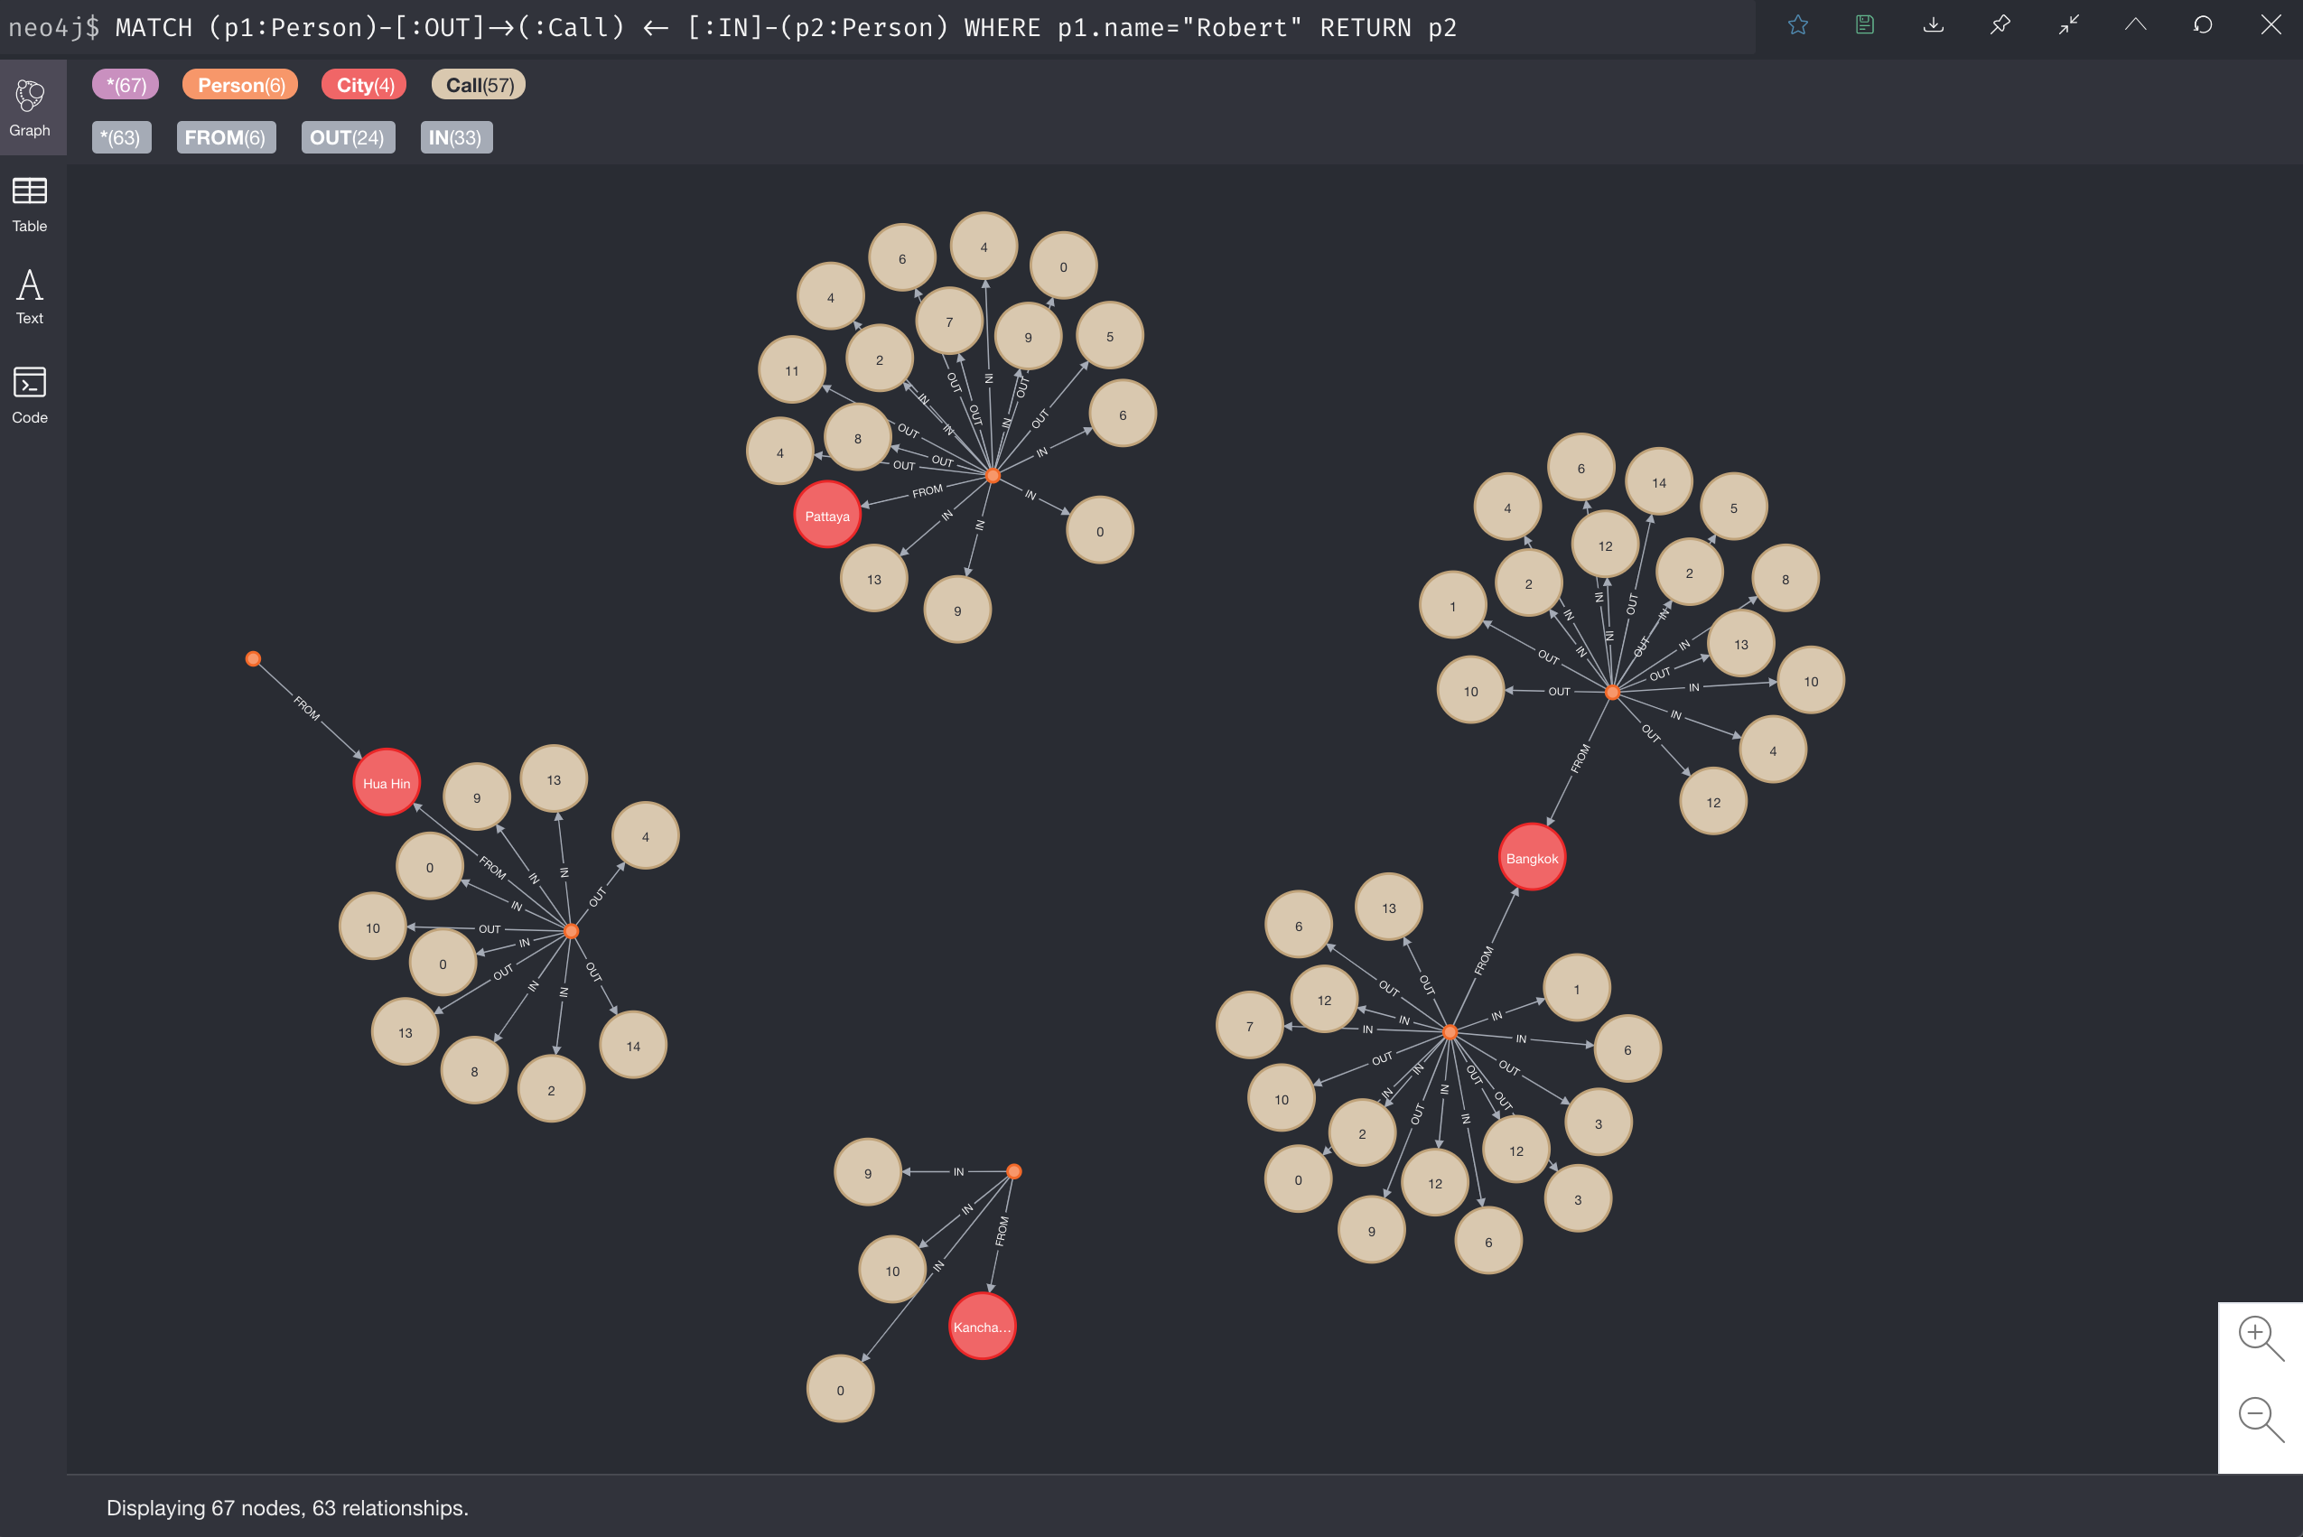
Persons, who got a call from “Robert”

Slide 17
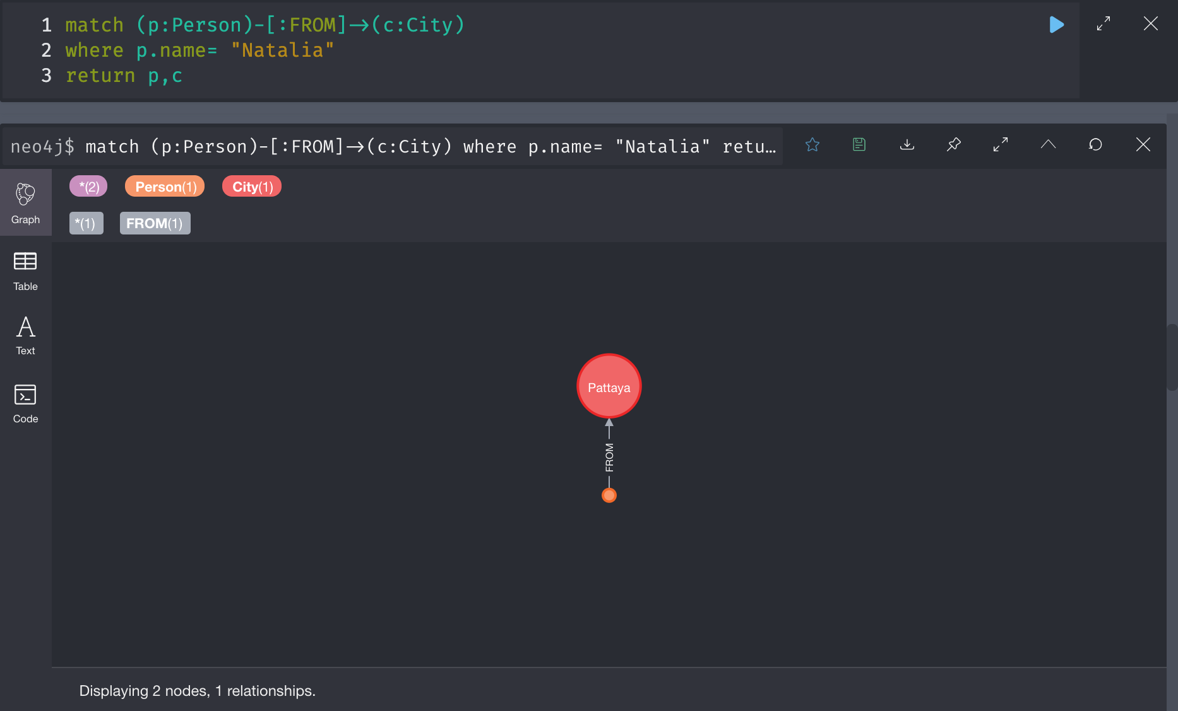

Slide 18
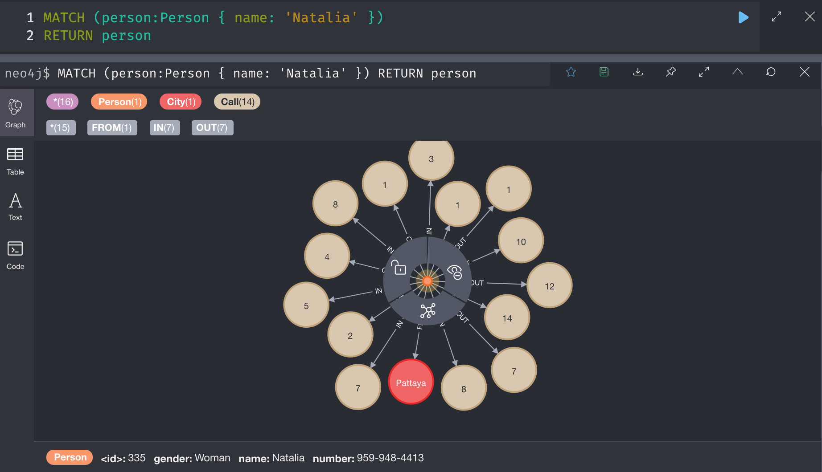

Slide 19
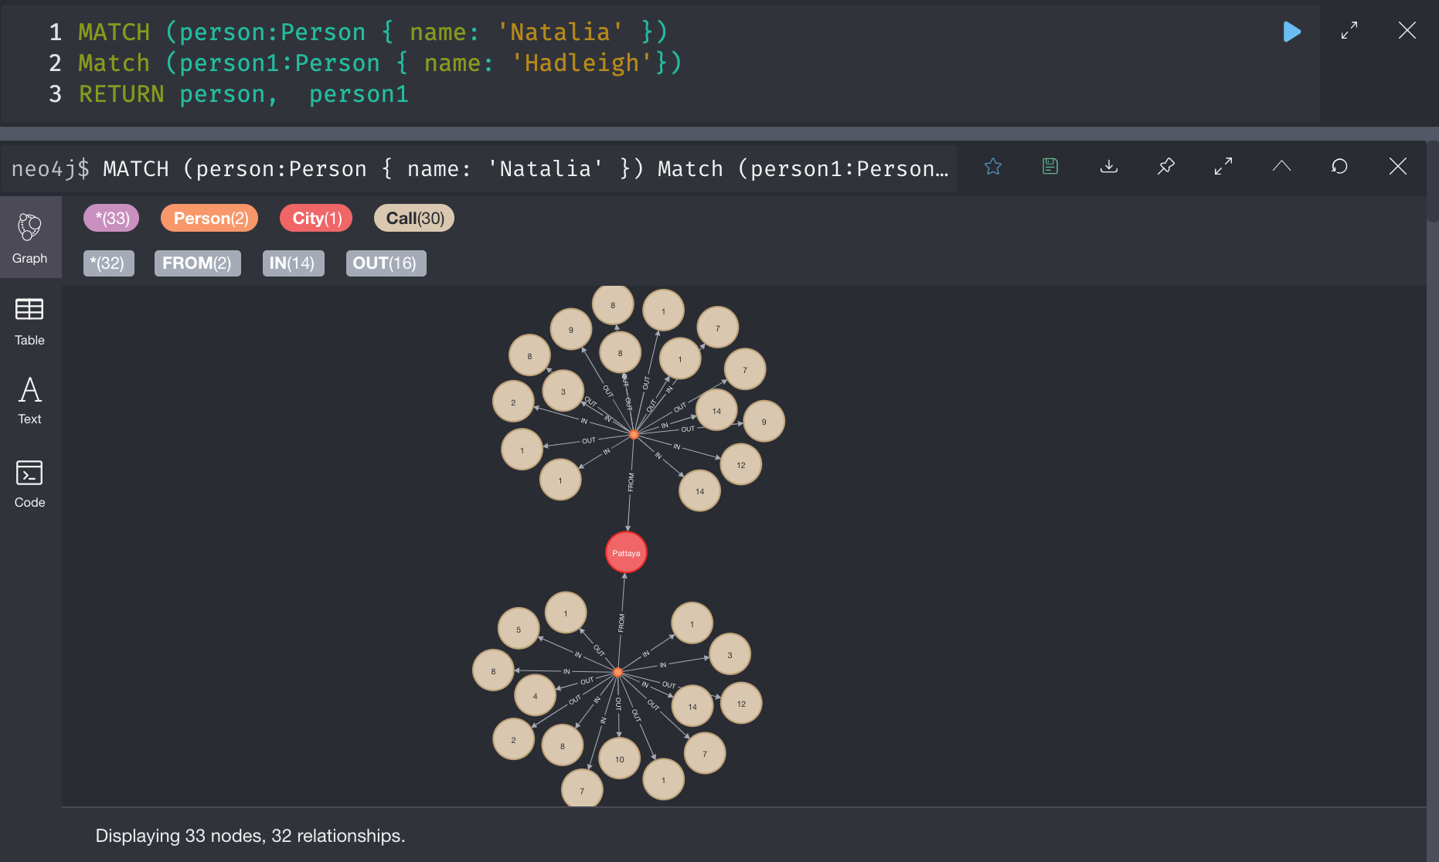

Slide 20

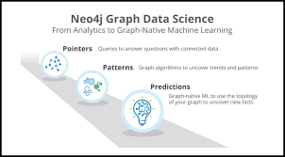
What is Neo4j?
Neo4j is an open-source, NoSQL, native graph database that provides an ACID-compliant transactional backend for your applications. Initial development began in 2003, but it has been publicly available since 2007. The source code, written in Java and Scala. Neo4j has both a Community Edition and Enterprise Edition of the database. The Enterprise Edition includes all that Community Edition has to offer, plus extra enterprise requirements such as backups, clustering, and failover abilities.
Neo4j is referred to as a native graph database because it efficiently implements the property graph model down to the storage level. This means that the data is stored exactly as you whiteboard it, and the database uses pointers to navigate and traverse the graph. In contrast to graph processing or in-memory libraries, Neo4j also provides full database characteristics, including ACID transaction compliance, cluster support, and runtime failover - making it suitable to use graphs for data in production scenarios.

Slide 21
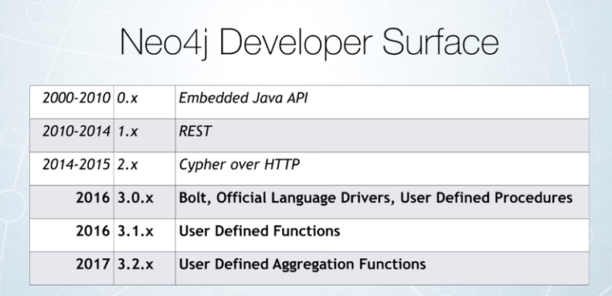
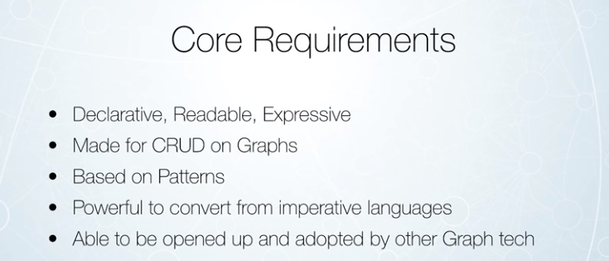

Slide 22
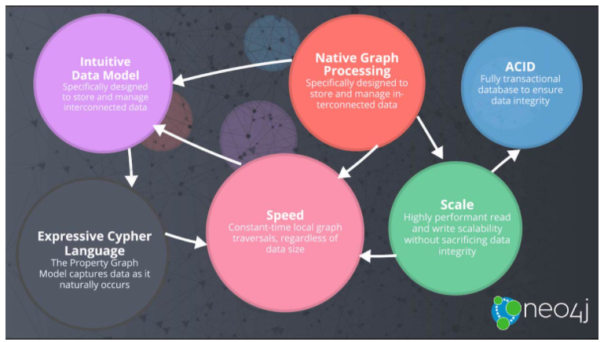
Below features make Neo4j very popular among developers, architects, and DBAs:
Cypher, a declarative query language similar to SQL, but optimized for graphs. Now used by other databases like SAP HANA Graph and Redis graph.
Constant time traversals in big graphs for both depth and breadth due to efficient representation of nodes and relationships. Enables scale-up to billions of nodes on moderate hardware.
Flexible property graph schema that can adapt over time, making it possible to materialize and add new relationships later to shortcut and speed up the domain data when the business needs change.

Slide 23
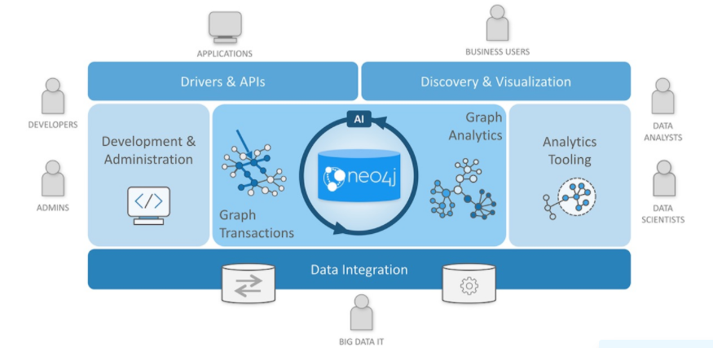
Components of the Neo4J Graph Platform:
Neo4j Graph Database - our core graph database that is built to store and retrieve connected data. There are two editions - a Community Edition and an Enterprise Edition. Everything in our platform interacts with data stored in the database.
Neo4j Desktop - application to manage local instances of Neo4j. Free download includes Neo4j Enterprise Edition license.
Neo4j Browser - online browser interface to query and view the data in the database. Basic visualization capabilities using Cypher query language.
Neo4j Bloom - visualization tool for business users that does not require any code or programming skills to view and analyze data.
Neo4j Aura - database-as-a-service offering managed by Neo4j for graph databases in the cloud.
Graph Data Science - officially-supported library for executing graph algorithms with Neo4j and optimized for enterprise workloads and pipelines.

Slide 24
What is the open Cypher Implementers Group?
The openCypher Implementers Group consists of openCypher implementers/vendors who collectively seek to
Ensure consistency between implementations of openCypher
Maintain and bugfix the openCypher query language
Transition planning from openCypher implementations to the developing graph query language standard, GQL
Members of the openCypher Implementers Group include Spark, RedisGraph, AnzoGraph, and Neo4j
Neo4j Integration Tools:
Neo4j Labs integrations:
APOC - the standard utility library of procedures and functions for Neo4j. GraphQL and GRANDstack - integrate with other popular data technologies or full-stack solutions. ETL Tool - migrate data from a relational database to Neo4j using an application and simple user interface.

Slide 25
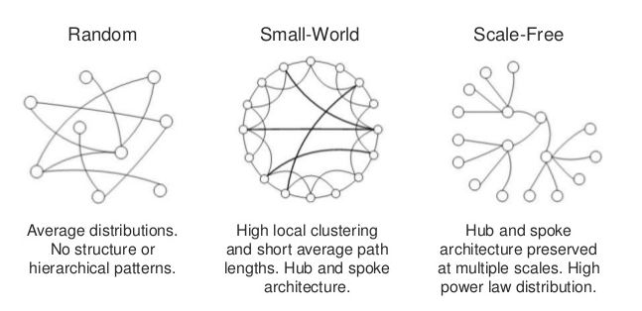
Graph data modeling is the process in which a user describes an arbitrary domain as a connected graph of nodes and relationships with properties and labels.
A Neo4j graph data model is designed to answer questions in the form of Cypher queries and solve business and technical problems by organizing a data structure for the graph database.
Getting started with Neo4j is easy. Take your first steps to become an expert Neo4j developer.
Install Neo4j or Start a Sandbox Online (http://sandbox.neo4j.com/)
Learn to Create and Query Data with Cypher
Import Your Data
Build an Application
Get Help on our Neo4j Online Community

Slide 26
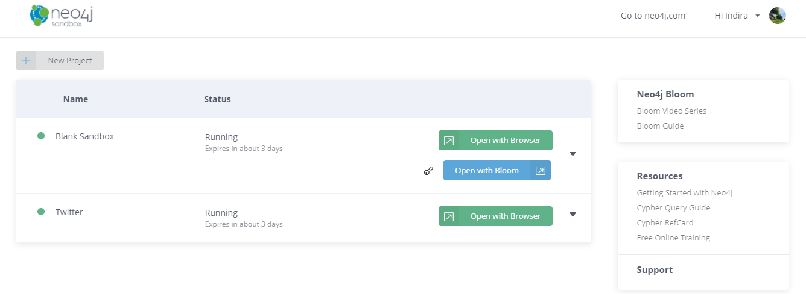
NEO4J Sandbox
Neo4j Sandbox is a great free way to try out Neo4j without downloading or installing anything locally.
It gives you access to Neo4j database, Neo4j Bloom, and plugins like Neo4j Graph Data Science, all hosted online and private to you. Once you sign in you can choose which project to spin up).
Both Neo4j and MongoDB are NoSQL databases. However, Neo4J is a graph database.
MongoDB does not create relationships between the database models, as each data set stored in the document store of the database is disaggregated and independent.

Slide 27
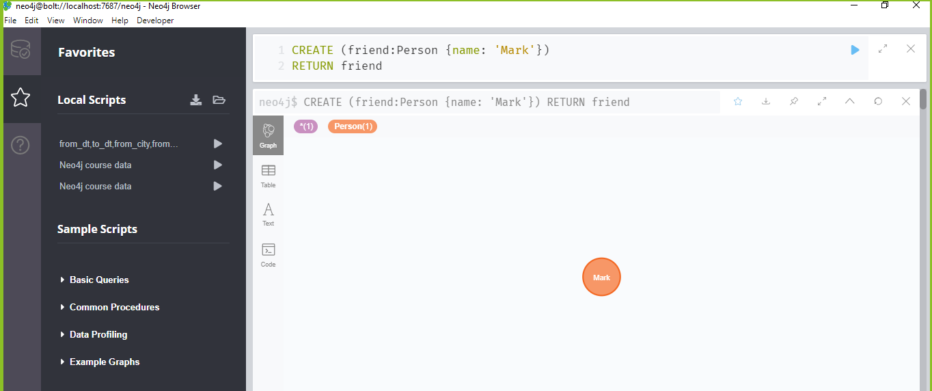
CRUD Operations
Create CREATE (friend:Person {name: 'Mark'})
RETURN friend (Inserting Data with Cypher)

Slide 28
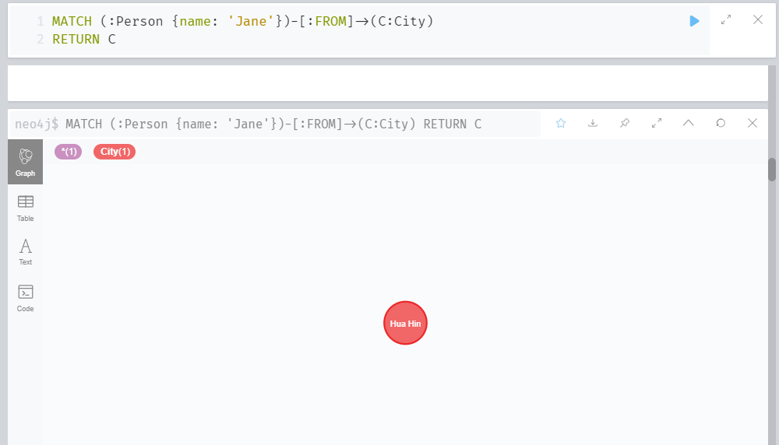
MATCH (:Person {name: 'Jane'})-[:FROM]->(C:City) RETURN C (View/read)

Slide 29
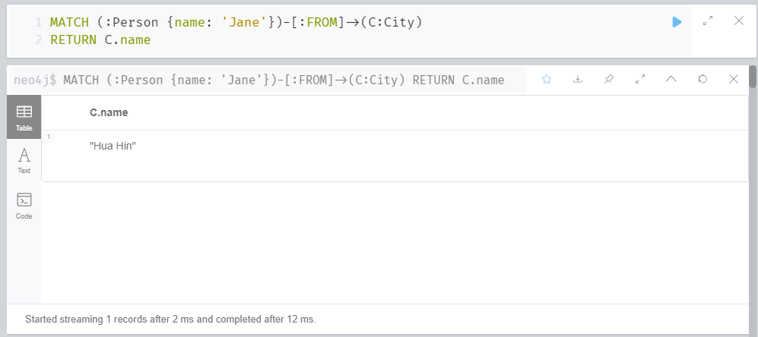
MATCH (:Person {name: 'Jane'})-[:FROM]->(C:City) RETURN C.name (view With out Graph)

Slide 30
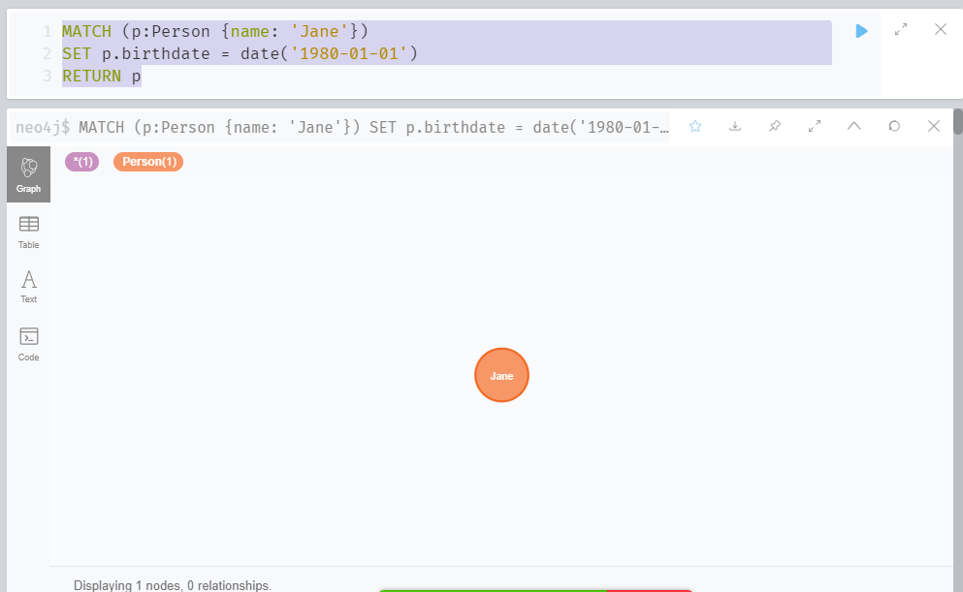
MATCH (p:Person {name: 'Jane'}) SET p.birthdate = date('1980-01-01') RETURN p (Updating Data with Cypher)

Slide 31
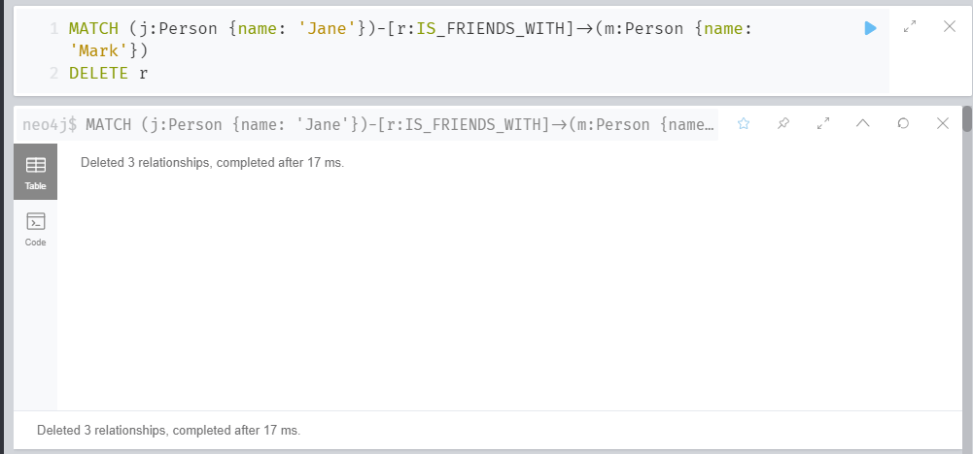
MATCH (j:Person {name: 'Jane'})-[r:IS_FRIENDS_WITH]->(m:Person {name: 'Mark'}) DELETE r (Delete)

Slide 32
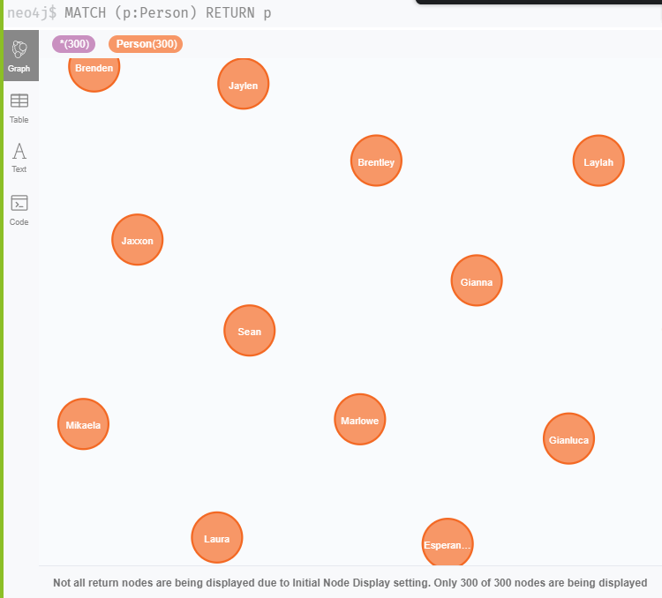
MATCH (p:Person) RETURN p (Not all return nodes are being displayed due to Initial Node Display setting. Only 300 of 300 nodes are being displayed)

Slide 33
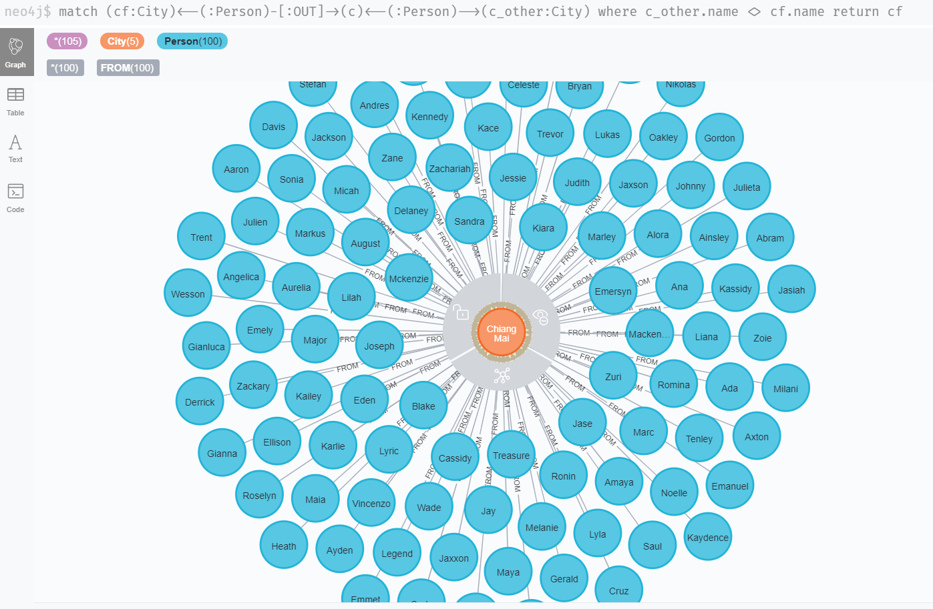
Questions we came across in Neo4j

Slide 34
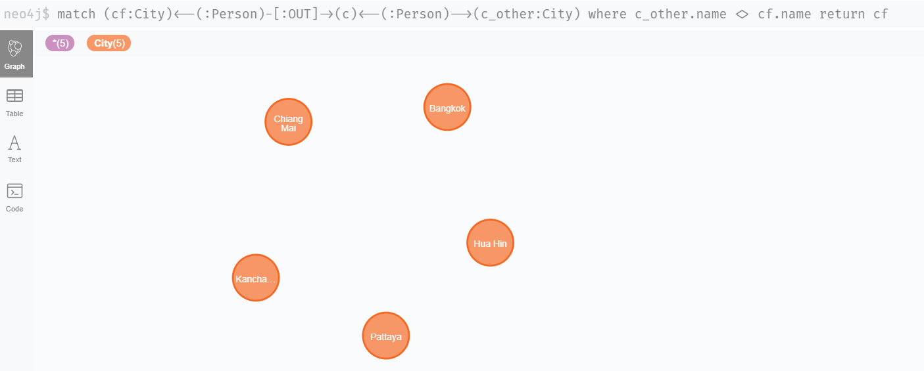
How many cities are we making use for analyzing the data of calling? Here we are showing Incoming and outgoing calling data of 5 cities calling from 2019-01-01 to 2019-07-30.

Slide 35
Find out the names of person who received or dialed calls in the city ? The graph is showing Person names for the city Chiang Mia who receive or dialed calls. So, Below result shows that there 100 Person who dialed or received the call.

Slide 36
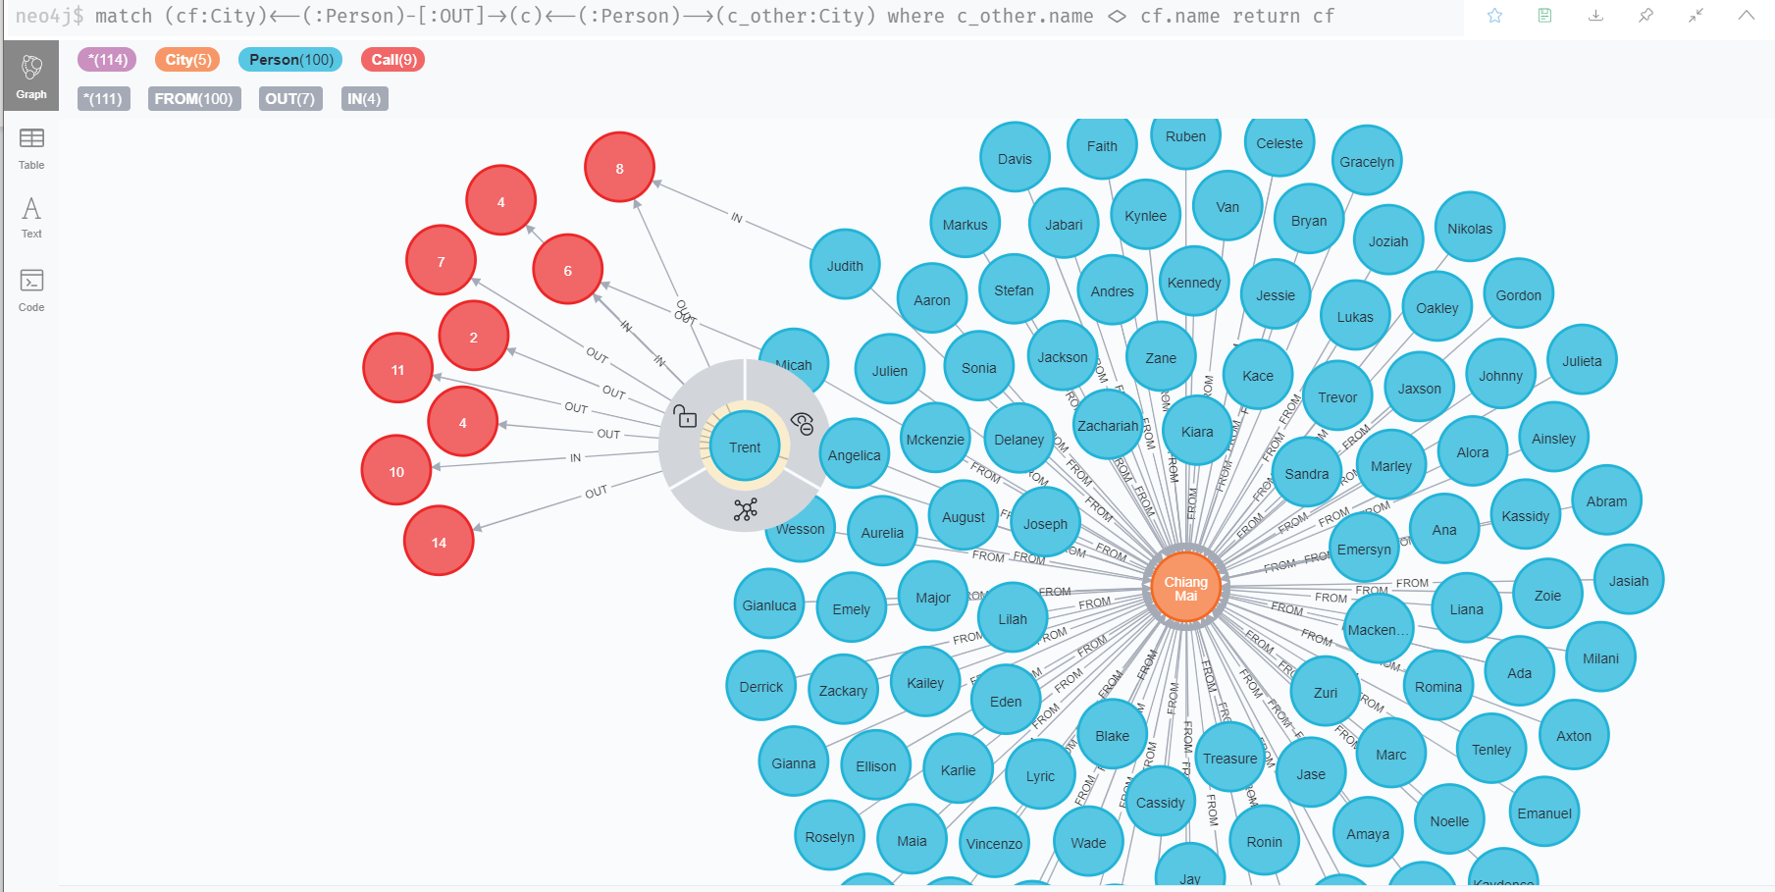
The number of incoming and outgoing calls did by individual person from Chiang Mia city? Here we can see Trent from Chiang Mia has received 4 calls and have dialed 7 calls.

Slide 37
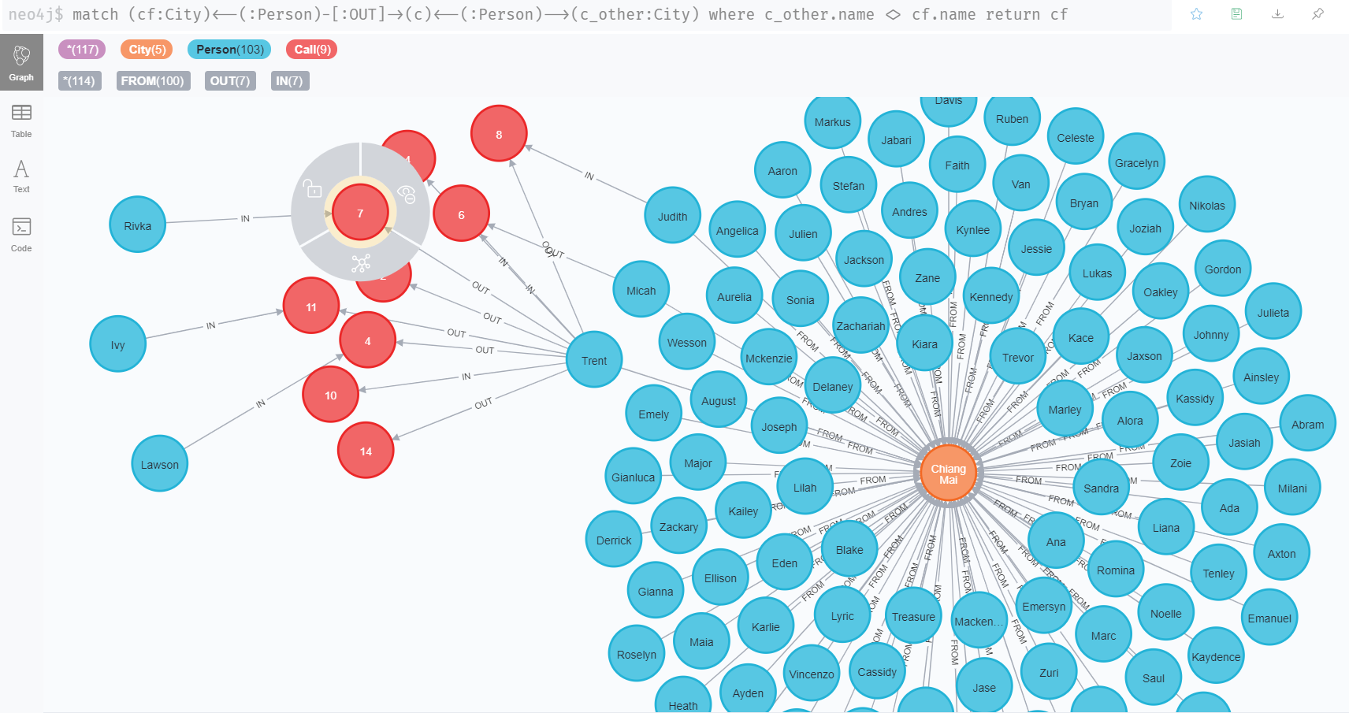
The names of persons the Trent called or received call from? Here we are showing the names of the person to whom he called and receive call from:

Slide 38
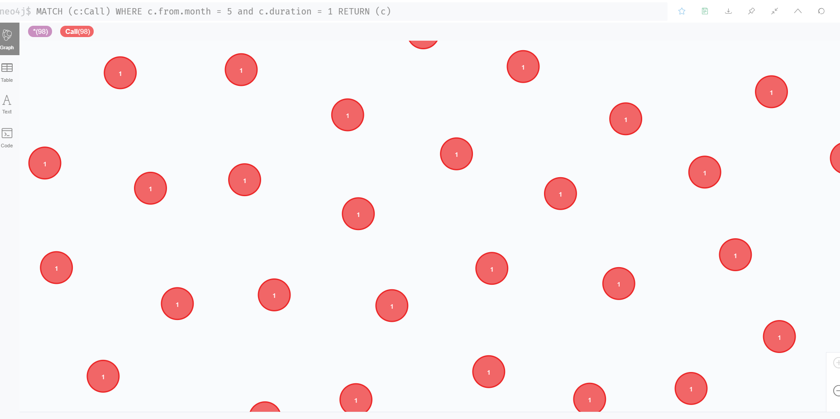
How many calls were missed in the month of May? For the duration of ‘1 Minute’ , there are total 99 missed calls for the month of may

Slide 39
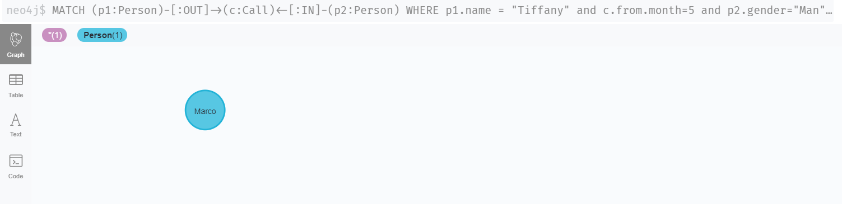
Find a name of a man, who received a call from Tiffany in May? In the 5th month of the year which is on MAY, Tiffany got a call from only one man that is MARCO..

Slide 40
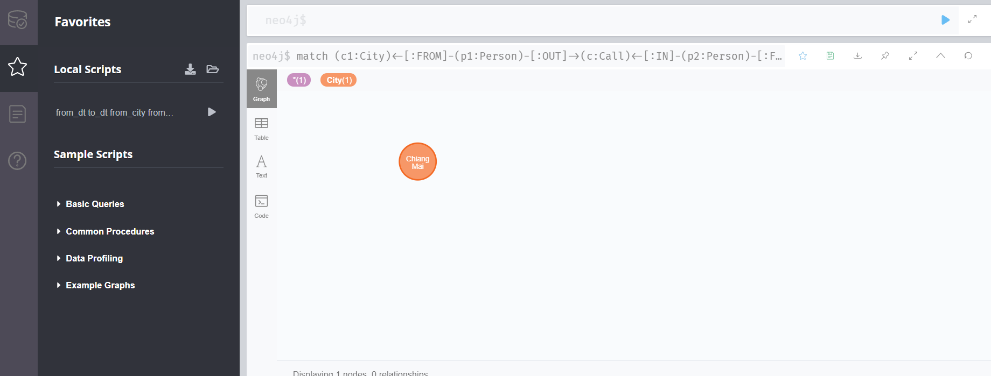
Find a city with the lowest number of internal city calls? We came across the result as Chiang Mia was the only city from the other 5 cities who has the lowest number of internal city calls.

Slide 41
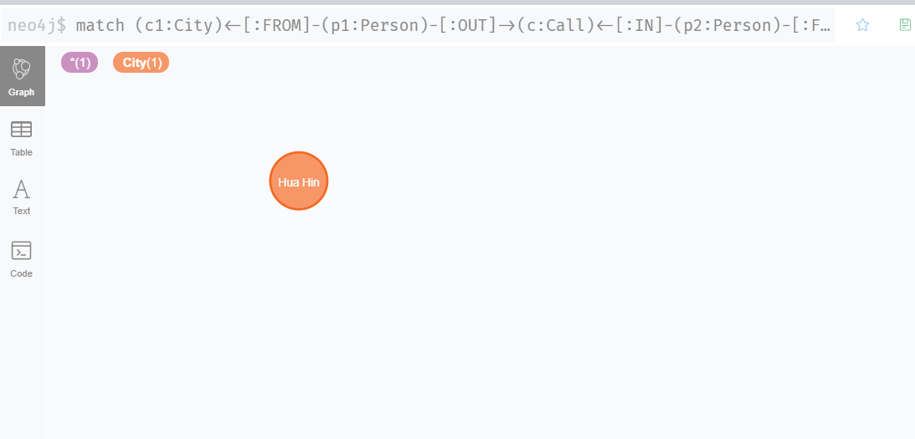
Find a city with the highest number of internal city calls? We got result as Hua Hin. The city with highest number of internal city calls

Slide 42
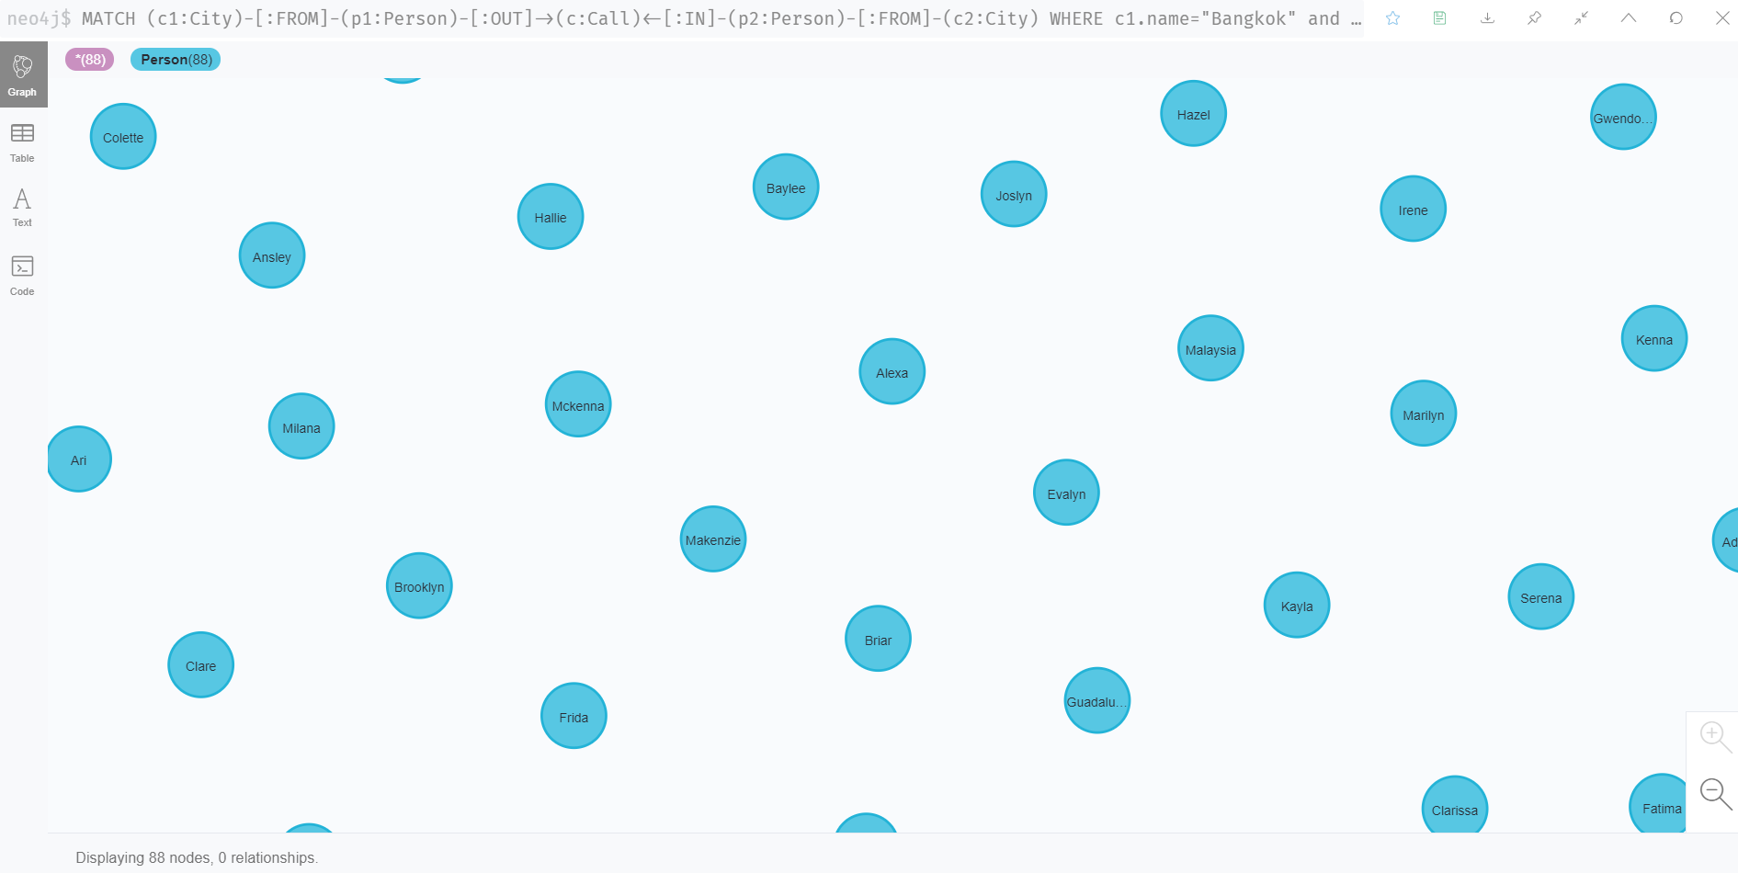
How many women from Pattaya received calls from Bangkok men? In Pattaya 88 women’s received call from Bangkok men.

Slide 43
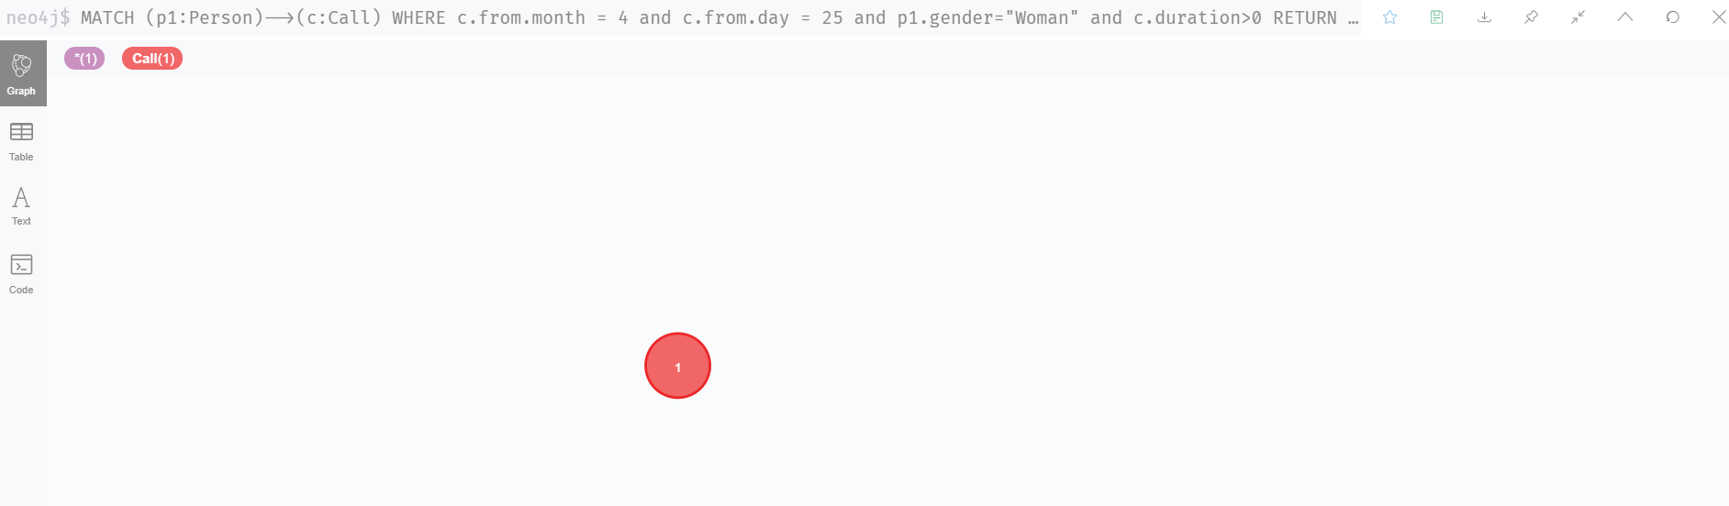
On date 25 of April, find the women who has least duration of conversations? So we kept the duration>0 and we found that there is only 1 women who has least duration of conversation on 25th April.

Slide 44
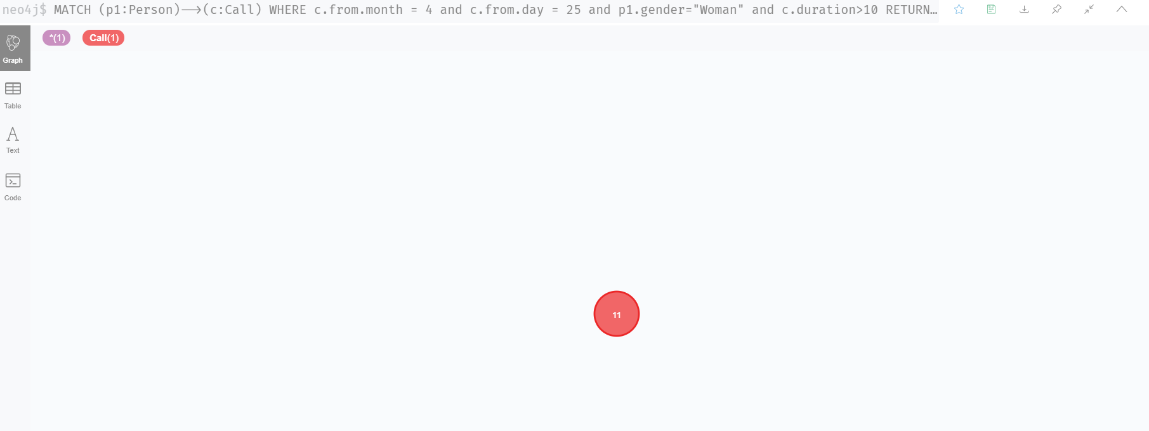
On date 25 of April, find the woman who has highest duration of conversations? So we changed the duration to >10. We got 11 woman’s who has highest duration of conversation on 25th April.

Slide 45
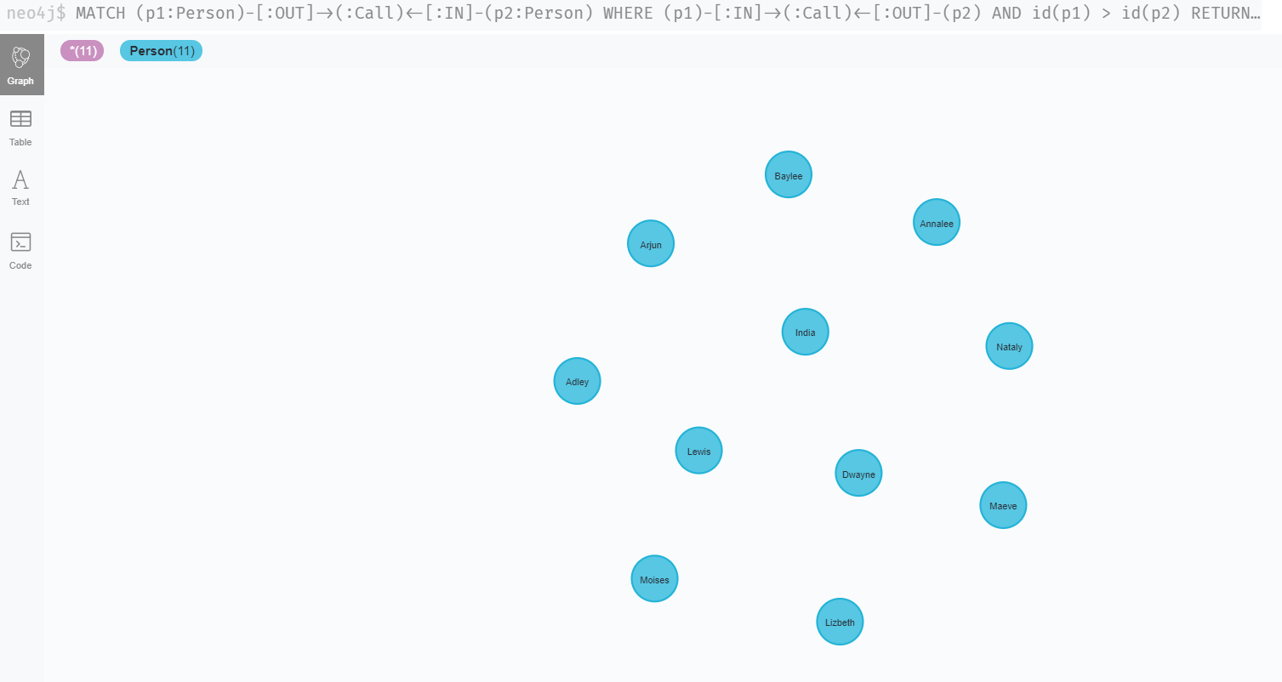
How many individual pairs of people called to each other? We came across the result as there were 11 individual pairs, who called each other.

Slide 46
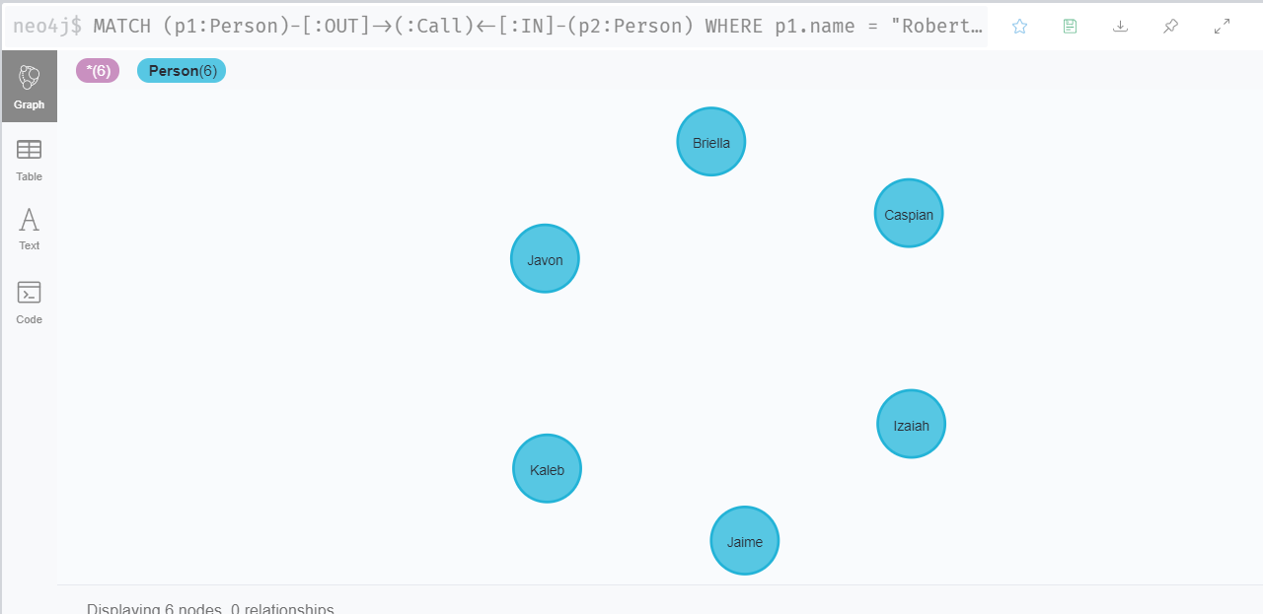
How many calls Robert did , and to whom? Robert called 6 persons.

Slide 47
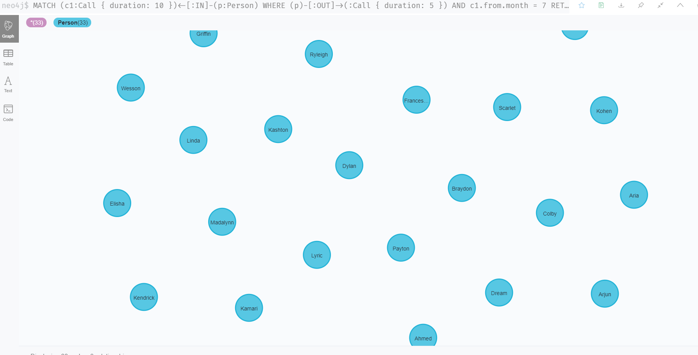
List all persons received 10 minutes calls in July and made 5 minutes calls? There were total 33 people, who received calls for duration of 10 and 5 minutes.

